Slide 1
Global Trends: DRR and Preparedness in Context
Helsinki, April 13th 2011

Slide 2
The Big Picture
Notes:
Go to gapminder.org/world. Select nutrition and GDP

Slide 3
Where we spend HA...

Slide 4
Where we spend ODA...

Slide 5
Aid is rising...

Slide 6
...and donors have different priorities.
Source: Development Initiatives based on OECD DAC, December 2010

Slide 7
The Funding Context
Notes:
Go to gapminder.org/world. Select nutrition and GDP

Slide 8
Donor governments under pressure...
GNI: Top 10 DAC donors

Slide 9
... and total aid doesn’t appear affected...

Slide 10
... But figures mask individual changes...

Slide 11
What are we responding to?
Notes:
Go to gapminder.org/world. Select nutrition and GDP

Slide 12
 | 2005 | 2006 | 2007 | 2008 | 2009
Afghanistan
Angola
Burundi
Cambodia
Cameroon
Central African Rep.
Chad
Comoros
Congo
Congo, Dem. Rep.
Cote d'Ivoire
Djibouti
Eritrea
Gambia
Guinea
Guinea Bissau
Haiti
kribati
Lao
Liberia
Mauritania
Nigeria
Pakistan
Papa New Guinea
Sao Tome
Sierra Leone
Solomon Islands
Sudan
Tajikistan
Timor Leste
Togo
Tonga
Uzbekistan
Vanatu
Yemen
Zimbabwe
Fragility and Conflict
 | Fragile states
 | Conflict affected
 | Fragile and conflict affected
32 | 33 | 30 | 27 | 29
Notes:
Source: World Bank IDA Resource Allocation Index
Country scoring less than 3.2

Slide 13
And natural disasters...
Source: CRED
Notes:
Source: CRED

Slide 14
And remains very concentrated.
Top Ten: 73% of ODA & HA
Source: OECD DAC and World Bank

Slide 15
The Missing Money
Notes:
Go to gapminder.org/world. Select nutrition and GDP

Slide 16
Do we understand the full context of humanitarian aid? Globally?

Slide 17
What about private contributions?
Source: GHA Report 2010, Development Initiatives
Notes:
Figures for 2009 are estimated/preliminary

Slide 18
...peacekeeping?

Slide 19
And the military? Afghanistan?
Source: Afghanistan: tracking major resource flows 2002-2010, GHA Briefing Paper, Development Initiatives, January 2010

Slide 20
Money sent home?
Notes:
Updated figures
Has not been verified by Asma et al

Slide 21
And a full range of donors.
2000 | 2001 | 2002 | 2003 | 2004 | 2005 | 2006 | 2007 | 2008 | 2009 | 2010
Korea | Saudi Arabia | Korea | Saudi Arabia | Korea | Saudi Arabia | Saudi Arabia | Saudi Arabia | Saudi Arabia | Saudi Arabia | Saudi Arabia
53.9 | 656.7 | 94.5 | 59.2 | 118.1 | 115.9 | 131.1 | 212.5 | 727.2 | 51.8 | 255.9
Saudi Arabia | Korea | Saudi Arabia | Kuwait | UAE | UAE | UAE | UAE | UAE | UAE | Turkey
11.7 | 68.8 | 28.8 | 27.2 | 101.4 | 99.8 | 43.8 | 45.1 | 110.6 | 35.3 | 60.9
China | Taiwan | South Africa | Korea | Saudi Arabia | Turkey | Kuwait | Korea | Kuwait | Kuwait | Brazil
6.0 | 1.0 | 19.8 | 26.6 | 35.1 | 78.7 | 24.2 | 30.3 | 95.6 | 34.2 | 39.6
Turkey | Qatar | Russia | Russia | Russia | China | Russia | Turkey | Russia | Russia | UAE
3.1 | 1.0 | 17.8 | 17.2 | 17.5 | 65.8 | 19.9 | 11.1 | 44.0 | 32.5 | 37.8
Romania | China | India | Qatar | Kuwait | Qatar | Korea | Kuwait | Korea | India | China
2.3 | 0.8 | 7.4 | 15.3 | 11.0 | 45.7 | 18.1 | 11 | 30.7 | 14.6 | 37.6

Slide 22
... and domestic capacity

Slide 23
DRR and Preparedness: The Challenge of Counting
Notes:
Go to gapminder.org/world. Select nutrition and GDP

Slide 24
Prevention and Preparedness
Humanitarian Aid Breakdown according to the CRS 2004 -2009

Slide 25
Prevention and Preparedness
Amount spent on disaster prevention and preparedness (CRS)
Currently the purpose code for disaster risk reduction activities falls within the codes for humanitarian aid under Disaster prevention and preparedness (74010)
Notes:
Disaster prevention and preparedness (74010) - Disaster risk reduction activities (e.g. developing knowledge, natural risks cartography, legal norms for construction); early warning systems; emergency contingency stocks and contingency stocks and contingency planning including preparations for forced displacement
4.2% of total HA in 2009. Gradual increase
The disaster prevention and preparedness code was only introduced in 2004 and only really started to be widely used by donors in 2007 (fig1).
The increase in 2005 is mainly made up of US$44.6 million donation from the United States to Iraq for a programme to ‘Restore Economically Critical Infrastructure’

Slide 26
The Major Recipients...
Recipients 2007
Bangladesh US$5.1m
Haiti US$3.8m
Pakistan US$3.1m
Bolivia US$2.6m
Philippines US$2.4m
Nepal US$2.3m
Sri Lanka US$1.8m
Peru US$1.8m
India US$1.8m
Viet Nam US$1.7m
Recipient s 2008
Bangladesh US19.6m
Indonesia US$ 11.7m
Dominican Republic US$9.6m
Kenya US$8.9m
Philippines US$7.4m
DRC US$7.4m
Ethiopia US$7.2m
Haiti US$6.1m
Sri Lanka US$5.6m
Mozambique US$4.5m
Recipients 2009
Bangladesh US$26.2m
Haiti US$20.7m
Indonesia US$17.1m
Philippines US$11.8m
Myanmar US$10.4m
India US$9.6m
Afghanistan US$8.7m
Bolivia US$6.5m
Pakistan US$6.4m
Peru US$6.4m
Notes:
CRS DATA

Slide 27
Bangladesh
Notes:
CRS DATA

Slide 28
Haiti
Notes:
CRS DATA
15% in 2009
3% in 2008
10% in 2007
2% in 2006

Slide 29
The donors...
Donors 2007
EU Institutions US$24.7m
UNDP US$15m
United States US$13.7m
Spain US$13.4m
Canada US$6.6m
Sweden US$4.6m
Belgium US$4.1m
Ireland US$3m
Australia US$2.3m
Denmark US$1.7m
Donor 2008
EU Institutions US$97.2m
Japan US$41.6m
UK US$32.6m
United States US$29.9m
Spain US$22m
UNDP US$17.9m
Australia US$13.6m
Ireland US$13.1m
Canada US$13m
Germany US$11.2m
Donor 2009
EU Institutions US$77.3m
United States US$58.7m
UK US$53.3m
Japan US$45.6m
UNDP US$31.6m
Australia US$27.7m
Germany US$25.3m
Sweden US$22.5m
Norway US$21.9m
WFP US$21.6m

Slide 30
Japan.
2008 - 12% of total funding to prevention and preparedness
2009 - 10% of total funding to prevention and preparedness

Slide 31
EC...
2008 - 28% of total funding to prevention and preparedness
2009 - 17% of total funding to prevention and preparedness

Slide 32
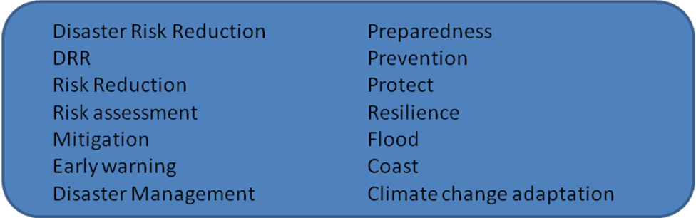
Unfortunately... Coding reveals much more.
EXAMPLES OF SEARCH TERMS
39 variations of search words coded in Macro
Notes:
The 2008 CRS data yield is higher than the US$343 million coded under disaster prevention and preparedness
Using the adopted methodology programmes and projects with elements of DRR were identified in the remaining purpose codes. A further US$476 million of funding was identified within development projects and US$66 million within other humanitarian codes/sectors (fig 2).
**NB: Important to note development projects with elements of DRR so figure not that reliable**

Slide 33
Tracking much more complicated
Recipients of disaster risk reduction within development funding
Bangladesh US$198m
Ghana US$98m
India US$15m
Viet Nam US11m
Kenya US$6m
Donors of disaster risk reduction within development funding
IDA US$97m
Japan US$42m
Canada US$33m
Germany US$30m
UK US$22m
Notes:
Data on DRR is hidden within many development sectors
Similar DRR projects can fall within HA and ODA

Slide 34
Japan 2009

Slide 35
Bangladesh 2009

Slide 36
Donors...

Slide 37
Complicated field of actors and/or bad reporting/coding?
HA Prevention and Preparedness Delivery | US$ m
NATIONAL NGOs | 7.3
United Nations Development Programme | 2.8
NGOs and civil society | 2.7
UNDP (Direct Execution) | 1.7
National Execution | 0.8
GTZ | 0.7
PUBLIC SECTOR (donor, recipient, other) | 0.6
Institute of water modelling | 0.4
LOCAL/REGIONAL NGOs | 0.2
Intergovernmental Oceanographic Commission | 0.2
Action Aid | 0.1
KOICA | 0.1
OTHER | 0.1
(blank) | 8.5
Development Delivery | US$m
AsDB - Asian Development Bank | 1.71
International Bank for Reconstruction and Development | 1.59
OTHER | 0.79
UNDP | 0.62
INTERNATIONAL NGOs | 0.24
Non-governmental organisations (NGOs) and civil society | 0.23
PUBLIC SECTOR (donor, recipient, other) | 0.21
International Institute for Environment and Development | 0.16
International Union for the Conservation of Nature | 0.14
BCAS - Bangladesh Centre for Advanced Studies | 0.12
Bangladesh Environmental Lawyers Association | 0.05
Middlesex University Higher Education Corporation | 0.03
CARE Canada | 0.01
(blank) | 3.80

Slide 38
DRR Tracking Conclusions
Data is the enemy... Should be on our side.
Semantics obscure and confuse
Cluttered world of institutions and actors
Financing unsure... Has the case been made?
DRR as a tool to better link our various approaches... Artificial distinctions.
Confused?

Slide 39
Needs, equity, choice and prioritisation?
Notes:
Go to gapminder.org/world. Select nutrition and GDP

Slide 40
Humanitarian needs are still going up...
UN CAP

Slide 41
... the number of undernourished is going up
Source: FAO
Notes:
Number of undernourished people in the world
Undernourished defined as when calories intake is below Minimum Dietary Energy Requirement (N.B. This is NOT a measurement used in emergency nutrition programming)

Slide 42
Day by day?
Notes:
Tracking equity of funding graph Pakistan 2010 floods.
This was from our last download mid November
UNOCHA FTS DATA

Slide 43
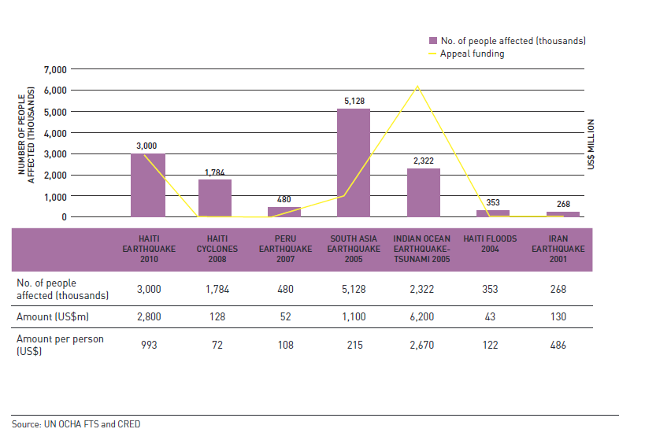
Over time?

Slide 44
... Do we make the right choices?

Slide 45
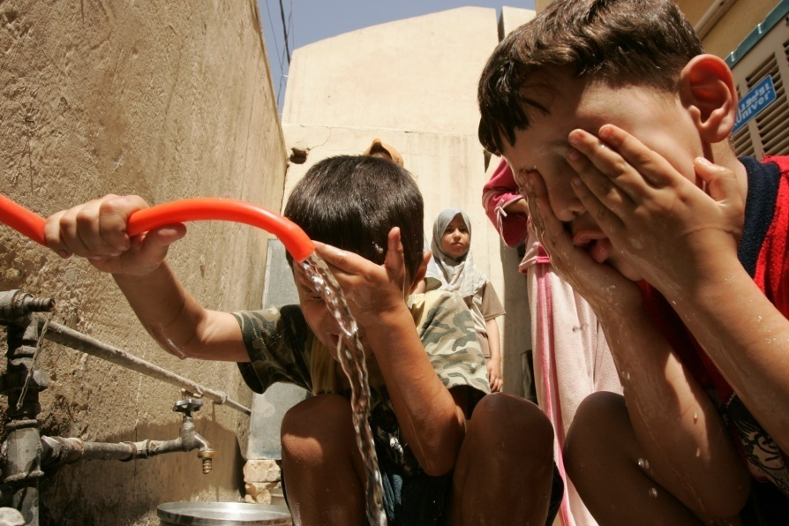
Clarity Counts.
We work to provide access to reliable, transparent and understandable information so that we can all work to ensure better outcomes for people affected by humanitarian crises.
Global Humanitarian Assistance is a Development Initiatives programme, funded by the governments of Canada, Denmark, the Netherlands, Sweden and the United Kingdom
Name: Jan Kellett
Email: jan@devinit.org
Tel: +44 (0)1749 671343
Web: globalhumanitarianassistance.org
Global Humanitarian Assistance, Development Initiatives, Keward Court, Jocelyn Drive, Wells, Somerset, BA5 1DB, UK

